Slide 1
Introductory Data Science and Machine Learning
CP1407
Lecture #3
Clustering

Slide 2
Lecture Overview
What is clustering analysis?
Distance function and normalisation
k-means clustering
Hierarchical clustering
Clustering evaluation

Slide 3
Pre-Reading List
Pre-Lecture work (reading) for students:
Textbook 2 (Data Mining: Practical Machine Learning Tools and Applications) – Chapter 4 (Section 4.7 and Section 4.8)
Han and Kamber (2012), “Data Mining: Concepts and Techniques” 3rd Edition. – Chapter 10

Slide 4
Clustering
Clustering: the process of grouping a set of objects into classes of similar objects
Samples within a cluster should be similar
Samples from different clusters should be dissimilar
Classes are not pre-defined

Slide 5
Clustering Example
Yahoo! Hierarchy is not clustering but is the kind of output you want from clustering
agriculture
biology
physics
CS
space
...
...
...
...
...
dairy
botany
cell
AI
courses
crops
magnetism
craft
forestry
agronomy
evolution
relativity
HCI
missions

Slide 6
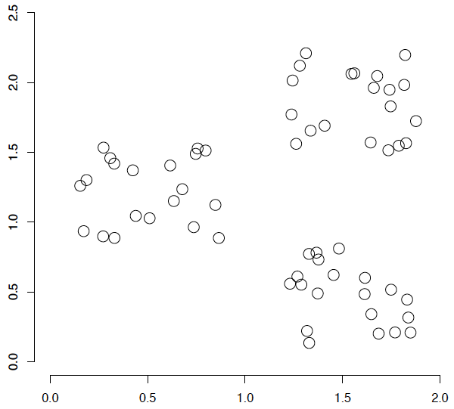
Cluster structure
How would you design an algorithm for finding the three clusters in this case?

Slide 7
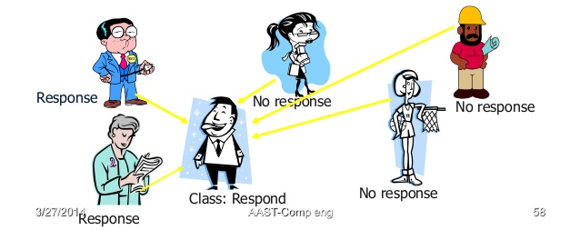
Instance-based Learning
Majority voting is used to label each instance using closest instances

Slide 8
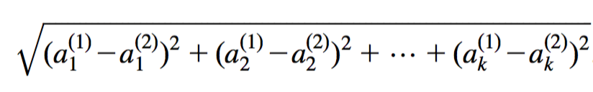
Distance function
Closest instances are determined using distance function.
Most instance-based schemes use Euclidean distance: a⁽¹⁾ and a⁽²⁾: two instances with k attributes

Slide 9
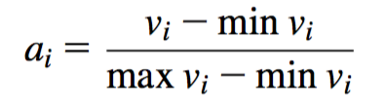
Normalization
Transform different features to the same range
Example : Normalize to range [0,1]:
v_{i} : the actual value of feature i

Slide 10
Outliers
Outlier: Data object that does not comply with the general behavior of the data
Noise or exception? Useful in fraud detection, rare events analysis
Outliers are detected as a separate cluster
Suspect
Normal

Slide 11
Clustering Algorithms
Flat algorithms: k means clustering
Input: a set of samples and the number k
Output: a partition of k (flat) clusters
Hierarchical algorithms
Input: a set of samples
Output: a (binary) hierarchy
Approach
Bottom-up, agglomerative
Top-down, divisive

Slide 12
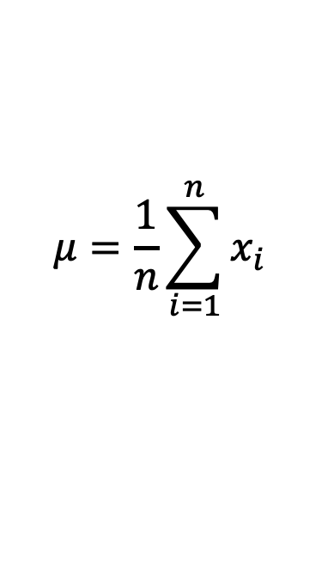
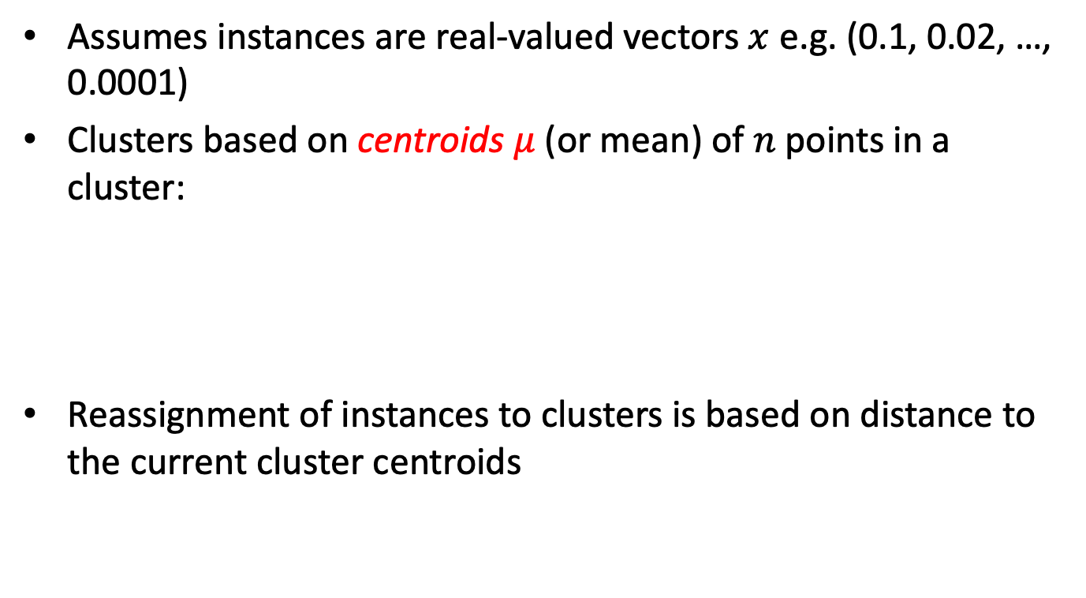
k-means
Assumes instances are real-valued vectors $x$ e.g. (0.1, 0.02, …, 0.0001)
Clusters based on centroids $μ$ (or mean) of $n$points in a cluster:
Reassignment of instances to clusters is based on distance to the current cluster centroids
$$μ=\frac{1}{n}\sum_{i=1}^{n}{x_{i}}$$

Slide 13
k-means example (k=2)
Pick seeds
Reassign clusters
Compute centroids
Reassign clusters
x
x
x
Compute centroids
x
x
x
Reassign clusters
Converged!

Slide 14
The k-means algorithm
Step 1: Choose k random cluster centers
Step 2: Assign each instance to its closest cluster center based on Euclidean distance
Step 3: Recompute cluster centers by computing the average (aka centroid) of the instances pertaining to each cluster
Step 4: If cluster centers have moved, go back to Step 2

Slide 15
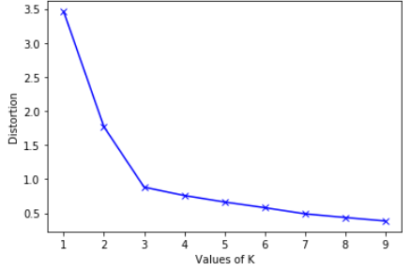
Number of Clusters
Tradeoff between having more clusters (better focus within each cluster) and having too many clusters
Increase number of cluster until average distance from centroids saturates (inflection point)
k = 3

Slide 16

Starting Centroids
Results can vary based on random seed selection
Seed 1 : Try with D and F
Seed 2 : Try with B and E
Select good seeds using a heuristic
e.g., doc least similar to any existing mean
Try out multiple starting points
Initialize with the results of another method
Seed 1
Seed 2

Slide 17
Hierarchical clustering
Standard hierarchical clustering performs clustering in a bottom-up manner; it performs agglomerative clustering:
First, make each instance in the dataset into a trivial mini-cluster
Then, find the two closest clusters and merge them; repeat
Clustering stops when all clusters have been merged into a single cluster

Slide 18
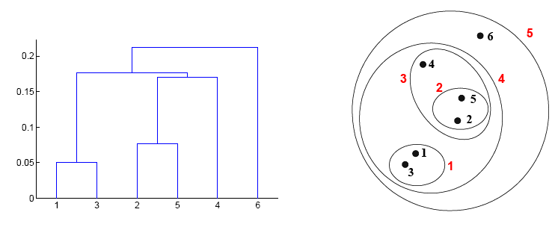
Dendogram
A tree like diagram that records the sequences of merges or splits
Any desired number of clusters can be obtained by ‘cutting’ the dendrogram at the proper level

Slide 19
Cluster Similarity
Outcome is determined by the distance function that is used
Single-linkage : use the two closest instances
Complete-linkage : use the two most distant instances
Cluster 2
Cluster 2
Cluster 1
Cluster 1
Single-link
Complete-link

Slide 20
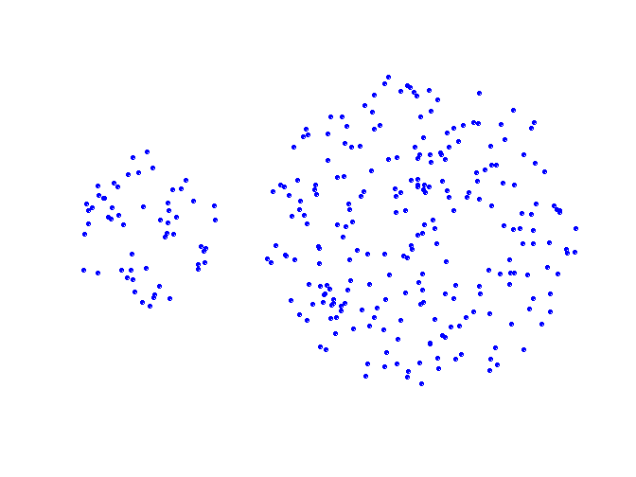
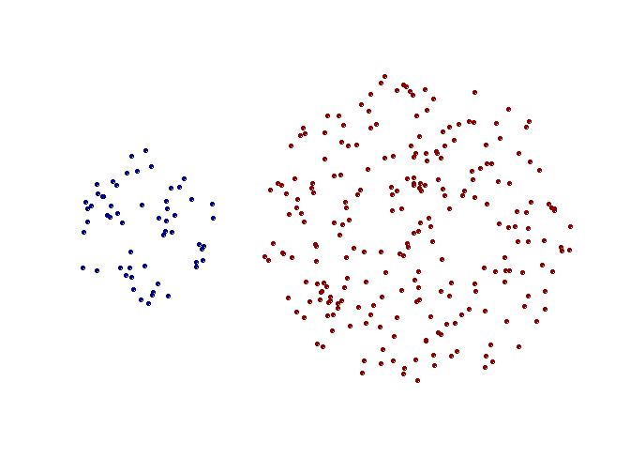
Single-link Example 1
Can handle non-global shapes
Original Points
Two Clusters

Slide 21
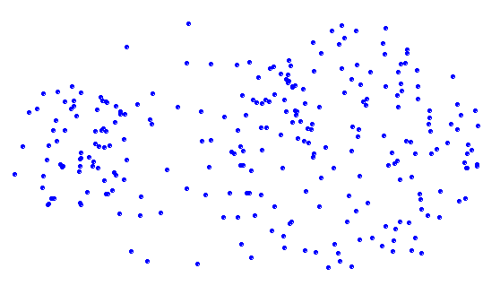
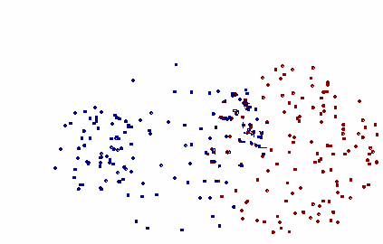
Single-link Example 2
Sensitive to noise and outliers
Original Points
Two Clusters

Slide 22
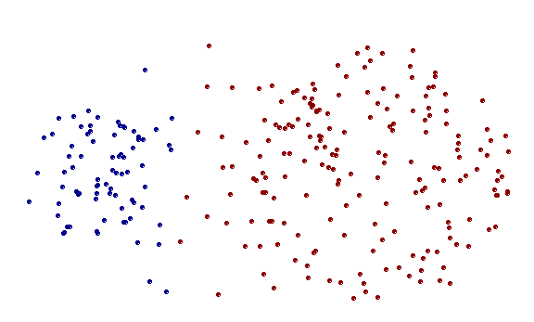
Complete-link Example 2
Less susceptible to noise and outliers
Original Points
Two Clusters

Slide 23
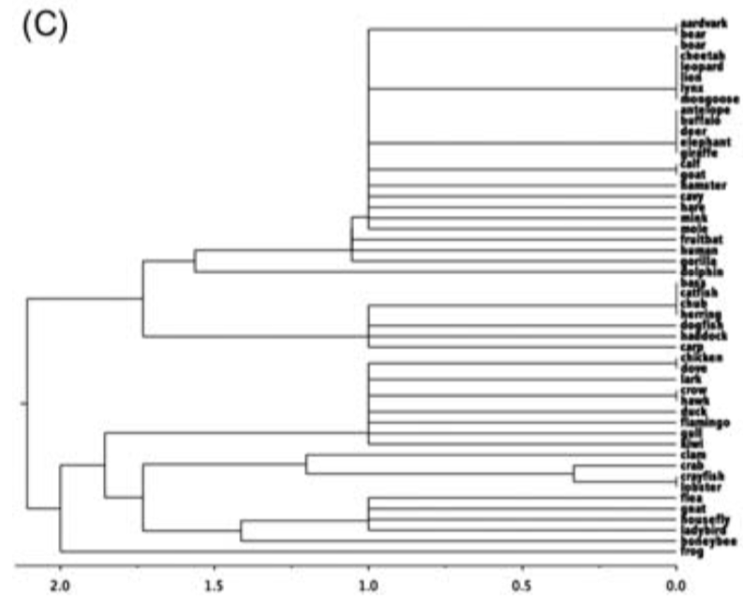
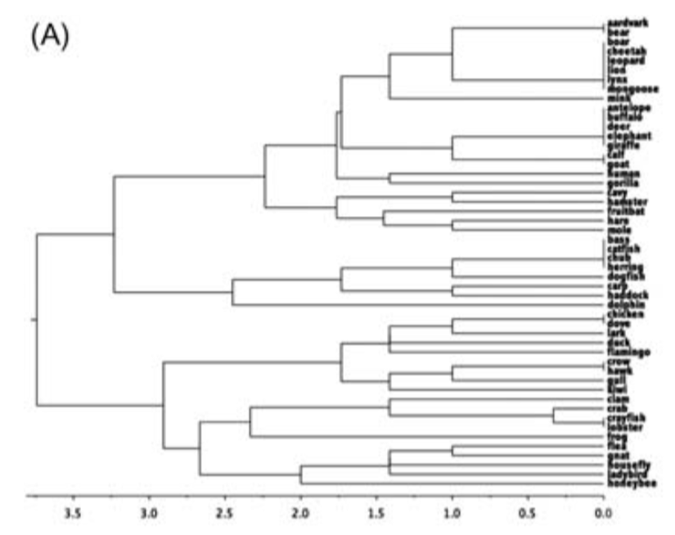
Compare Dendograms
Complete link gives a better distribution of samples
Single-link
Complete-link

Slide 24
Evaluation
A good clustering will produce high quality clusters in which:
The intra-class (that is, intra-cluster) similarity is high
The inter-class similarity is low
The measured quality of a clustering depends on both the sample representation and the similarity measure used

Slide 25
Purity
Purity is measured by its ability to discover some or all of the hidden patterns or latent classes in gold standard data
Assesses a clustering with respect to ground truth … requires labeled data

Slide 26
Example
• •
• •
• •
• •
• •
• •
• •
• •
•
Cluster I Cluster II Cluster III
Cluster I: Purity = max(5, 1, 0)/6 = 5/6
Cluster II: Purity = max(1, 4, 1)/6 = 4/6
Cluster III: Purity = max(2, 0, 3)/5 = 3/5

Slide 27

Summary
Clustering uses a distance function to group instances.
$k$-Means clustering is dependent on choice of seeds and number of clusters
Hierarchical clustering is dependent on choice of distance metric between two clusters
Labelled data can be used to evaluate the quality of clusters

